Slide 1
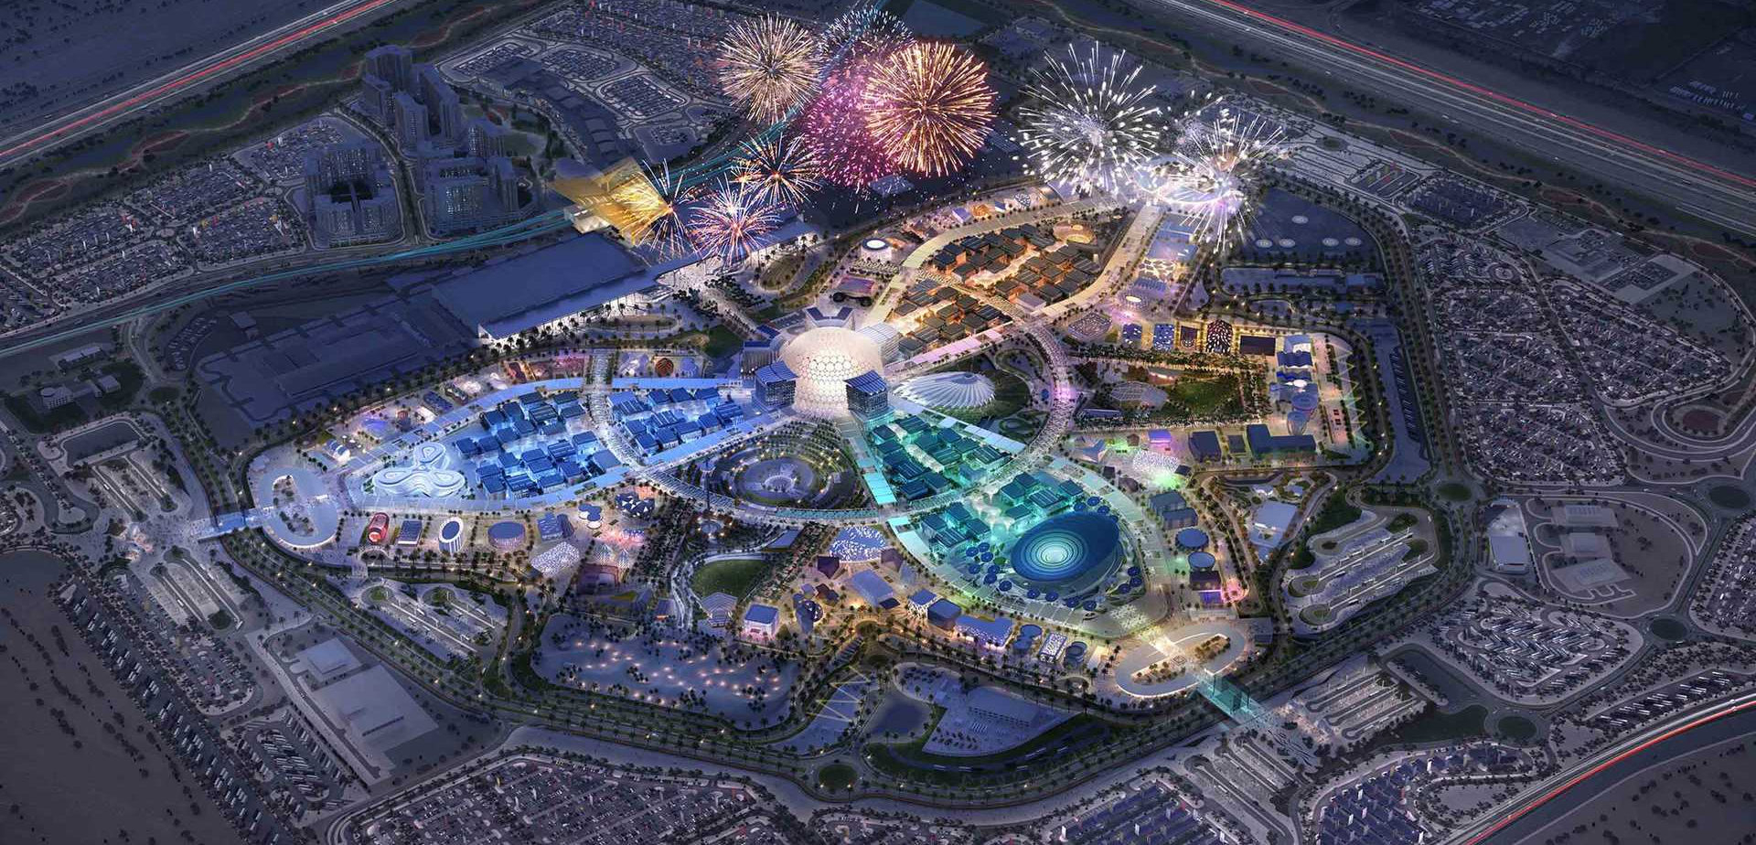
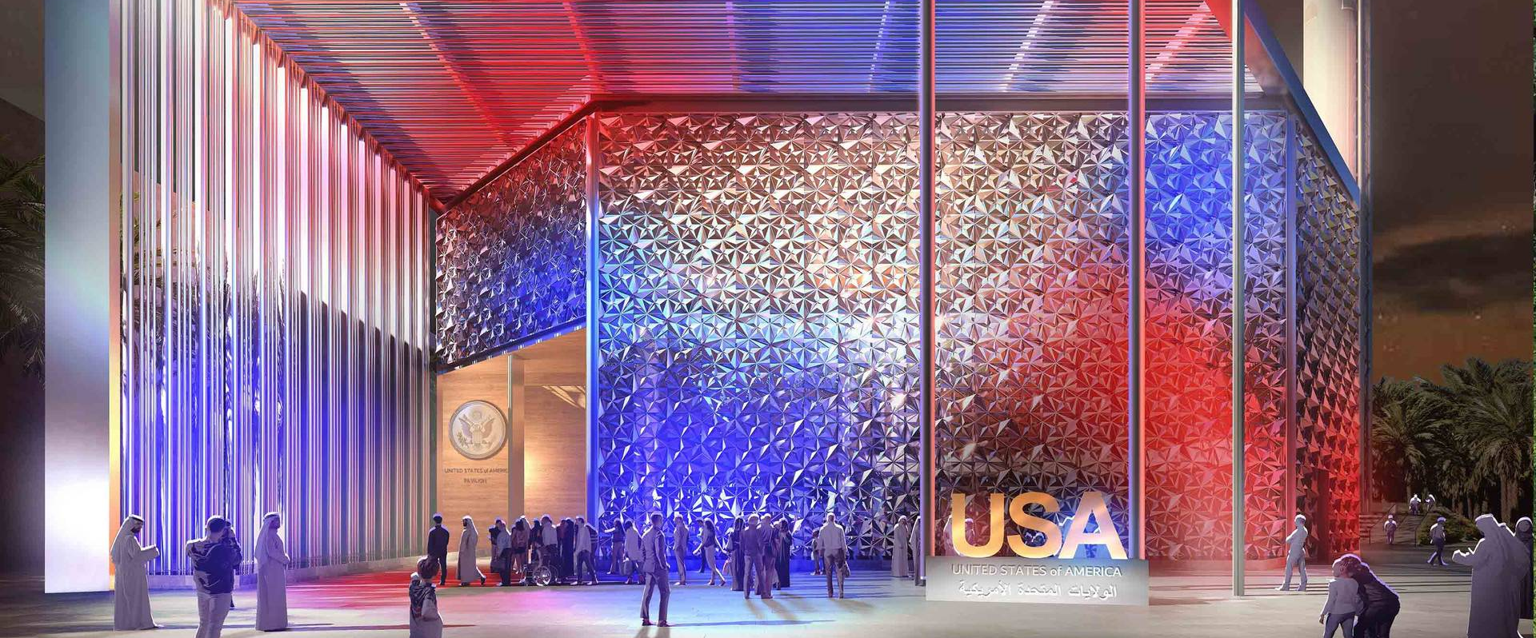
USA Pavilion
Cities, States, and Business

Slide 2
Agenda
What is an Expo?
Expo 2020 Dubai
Expo Theme Weeks/Trade Shows
Expo Business Forums
USA Pavilion
City/State Days – Trade Delegations

Slide 3
What is an International Exposition?
Also known as World’s Fairs or World Expo
Nation branding events - evolved from trade & technology fairs
Bureau of International Expositions (BIE) is the intergovernmental organization that regulates Expos
Two Types
World Expos: every 5 years (“0s and 5s”)
6 months long, self-build pavilions
Platforms aimed at finding solutions to universal challenges of our time
Specialized Expos, may occur in between World Expos
3 months long, building provided by organizers
Events dedicated to finding solutions to precise challenges of humanity

Slide 4
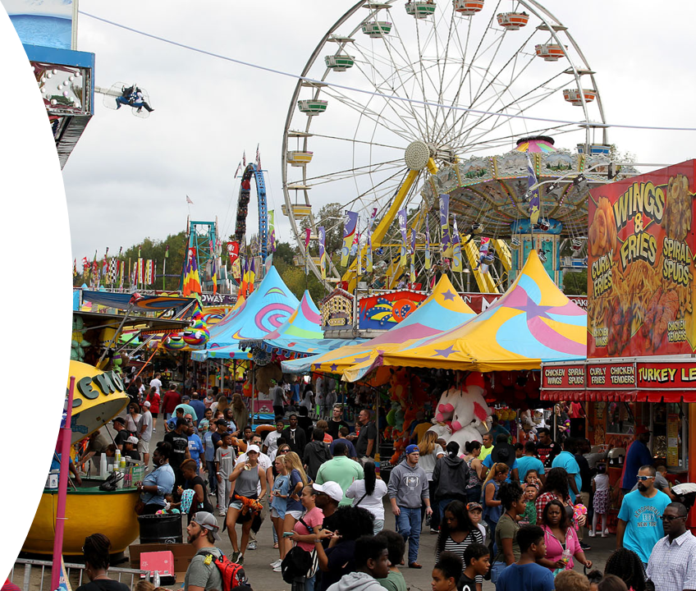
World’s Fairs are Not…
Dead
Trade Shows
Series of giant tents
A circus
A carnival or state fair
Only a few countries

Slide 5
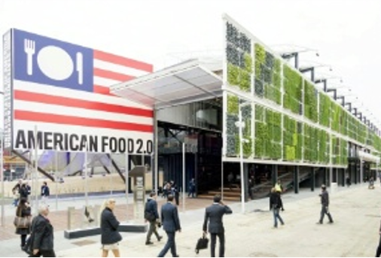
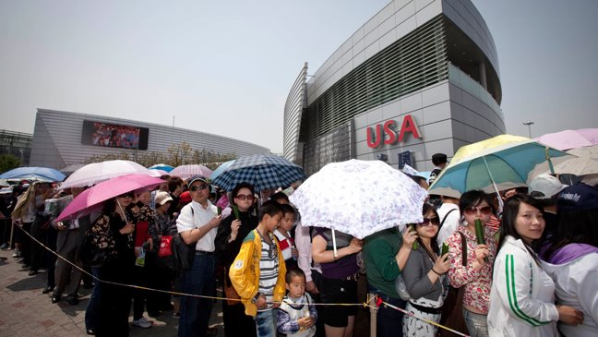
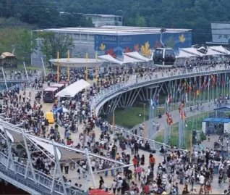
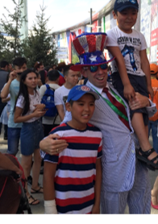
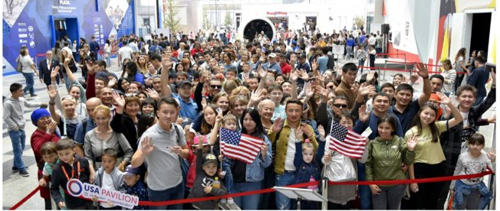
Milan 2015
Shanghai 2010
Big Pavilions
Inspiring Design
Large Crowds
Trade Delegations
Arts & Culture
Aichi 2005
Astana 2017
Astana 2017

Slide 6
The Site:
Expo 2020 Dubai
The first World's Fair to be held in the Middle East and among the first post-pandemic global mega events
October 1, 2021 - March 31, 2022
4 times the size of Disneyland
192 Country Pavilions, plus Corporate and Themed Pavilions
200+ restaurants, 60 live shows daily
16 total venues including outdoor amphitheaters, parks, concert stages, and exhibition halls.
More foot traffic expected than 2018 Olympics and the 2018 World Cup
Expo Theme: Connecting Minds, Creating the Future with a focus on Opportunity, Mobility, Sustainability

Slide 7
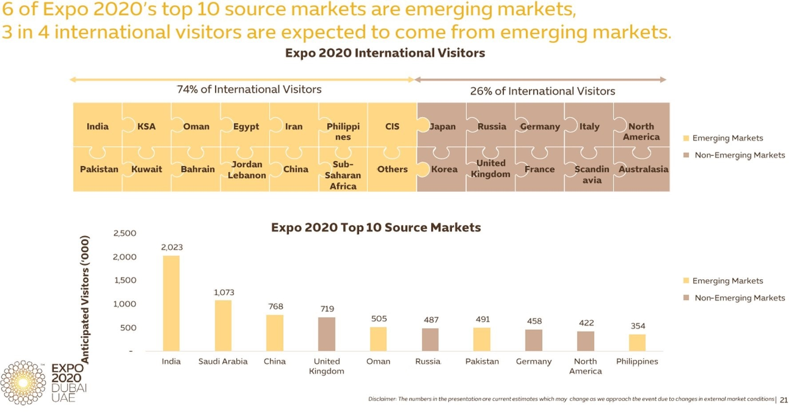
Expo 2020 Dubai Anticipated Audience (pre-COVID)¹
¹Source: Expo 2020 Dubai LLC

Slide 9
City/State Engagement Opportunities
Visit from a high-level delegation spanning the commercial and cultural spheres to participate in Expo 2020 theme weeks
Sponsor State Day at the USA Pavilion to coincide with a delegation visit
Support USA Pavilion programming with thought leaders/speakers and cultural performers

Slide 10
Theme Weeks
Suggest a Speaker or Cultural Performer – Participate in a Business Fora
CLIMATE & BIODIVERSITY
3-9 OCT 2021
TRAVEL & CONNECTIVITY
9-15 JAN 2022
SPACE
17-23 OCT 2021
GLOBAL GOALS
16-22 JAN 2022
URBAN & RURAL DEVELOPMENT
31 OCT – 6 NOV 2021
HEALTH & WELLNESS
30 JAN-5 FEB 2022
FOOD, AGRICULTURE & LIVELIHOODS
20-26 FEB 2022
TOLERANCE & INCLUSIVITY
14-20 NOV 2021
GOLDEN JUBILEE
5-11 DEC 2021
WATER
20-26 MAR 2022
KNOWLEDGE & LEARNING
12-18 DEC 2021

Slide 11
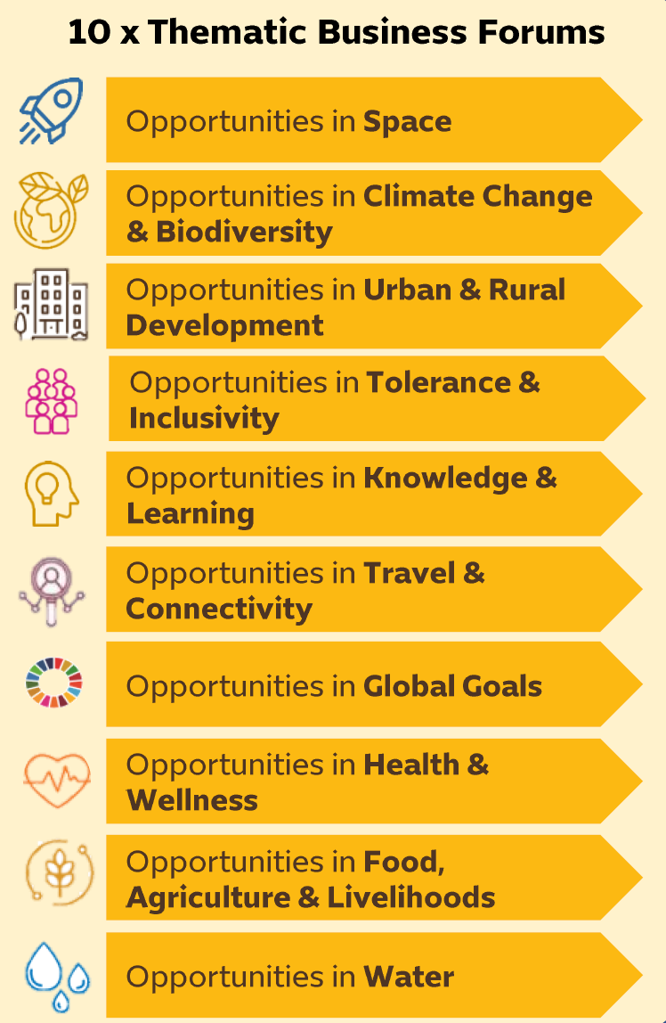
Thematic Business Forums
Dubai Chamber is organizing 10 Thematic Business Fora during Expo 2020. Likely to occur on Tuesday of the Theme Week at the Business Connect Center. Seeking American speakers/companies to participate. Limited to 300 people.
Collaboration between Expo 2020, Participants & Partners
Highlight non-traditional business opportunities
Opportunities for meaningful conversations and knowledge transfer

Slide 12
Trade Shows
Key Shows Taking Place during Expo 2020 (all in Dubai except where noted)
1. VIV MEA 2021 – International Trade Show from Feed to Food for the Middle East and Africa: Nov 23-25 [Abu Dhabi]
2. Arab Health (healthcare): Jan 2022
3. Gulfoods (food and beverage): Feb 2022

Slide 13
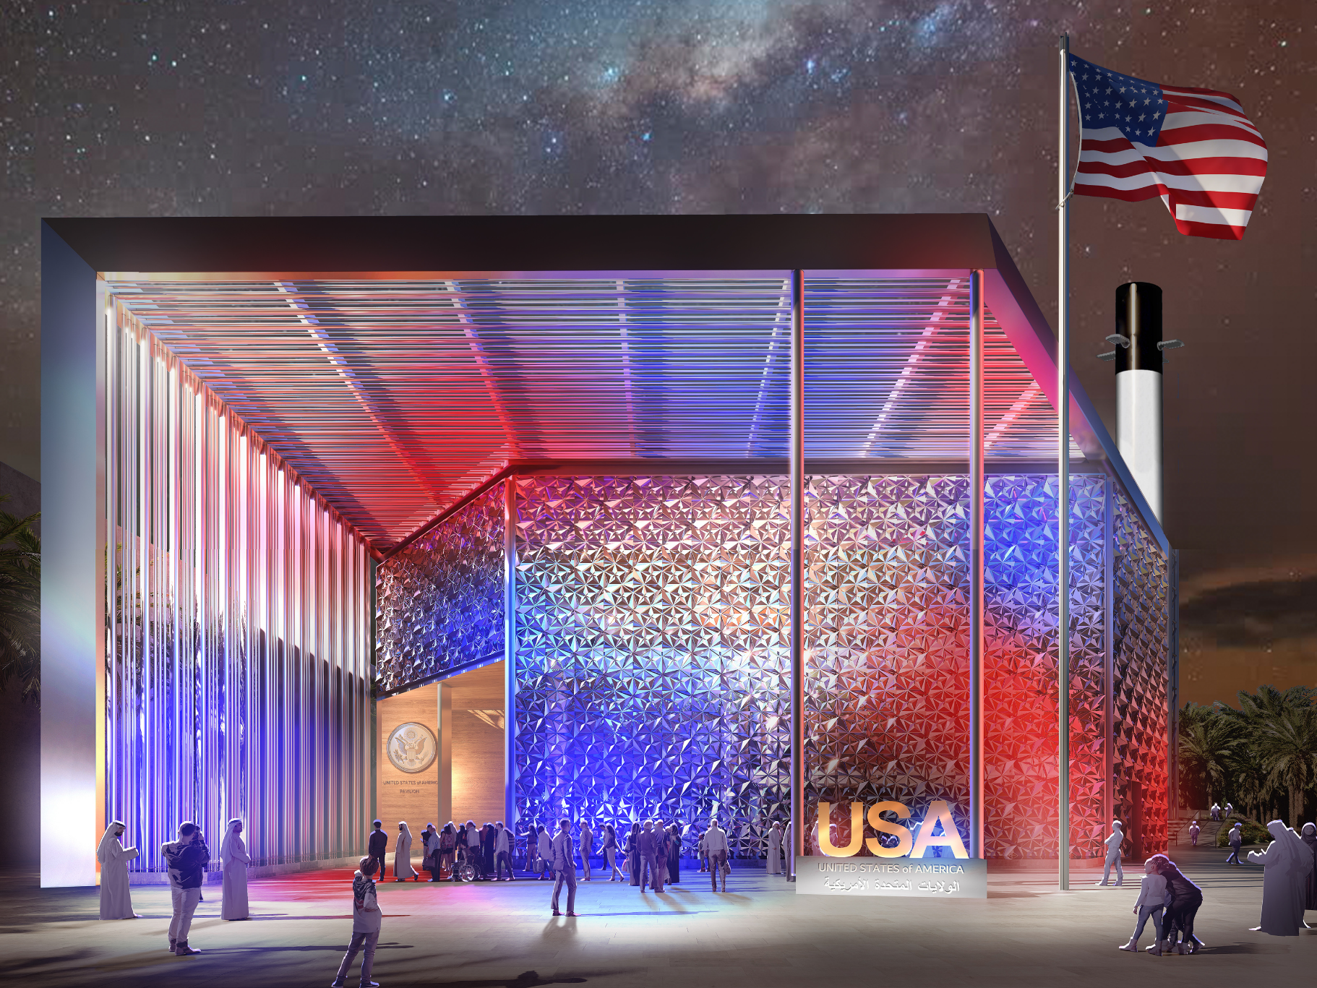
USA Pavilion: Life, Liberty, and the Pursuit of the Future
Prime location, near UAE pavilion
8 exhibit journey taking about 24 min
22,000 daily visitors anticipated with 5-6 million visitors over the entire Expo
20,623 SF indoor + outdoor space
U.S. National Day ~ Sunday, November 28, 2021
Attendance by USG delegations, U.S. business leaders, artists, and celebrities
Opportunities to highlight innovative and forward-thinking American companies that are driving the future
Once-in-a-generation opportunity to broadly reach a geopolitically and economically strategic region

Slide 14
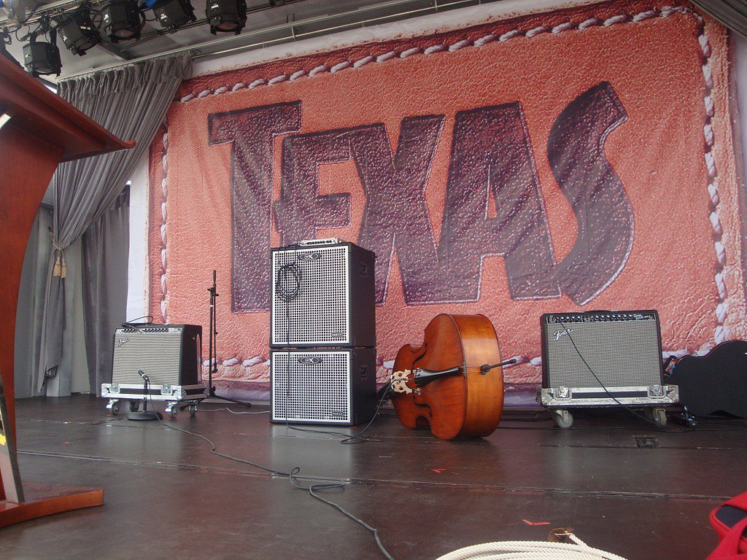
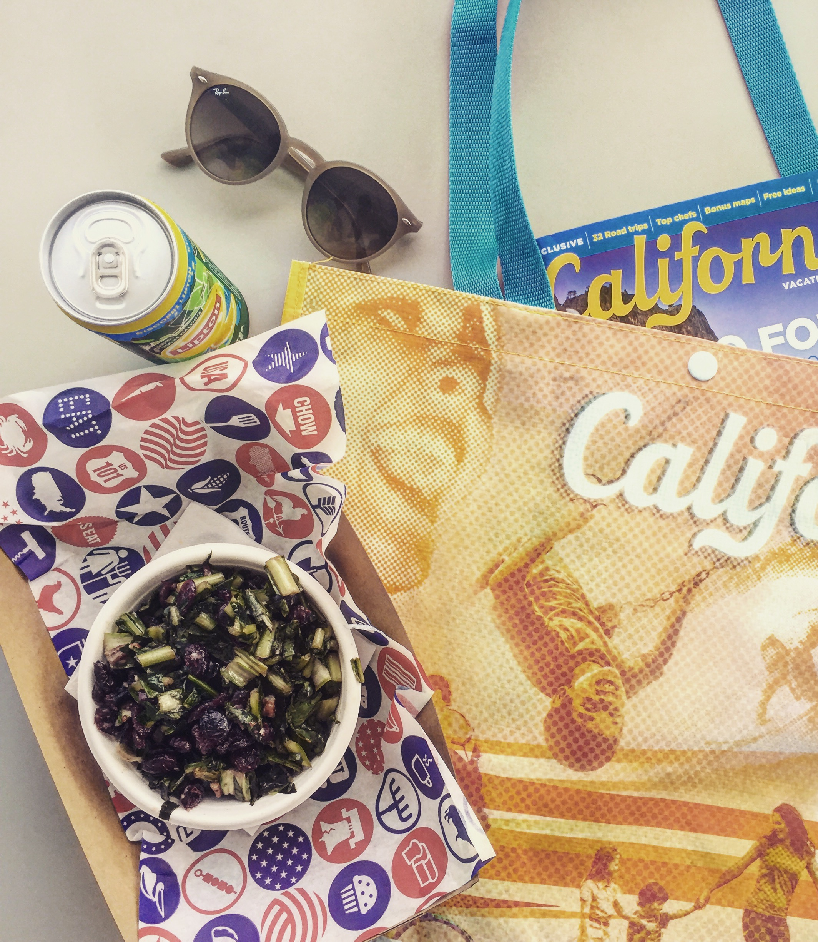
State Day
at the USA Pavilion
Opportunity to focus the Pavilion's outreach around State/City focused initiatives
May coincide with a delegation visit or can be a stand-alone promotion

Slide 15
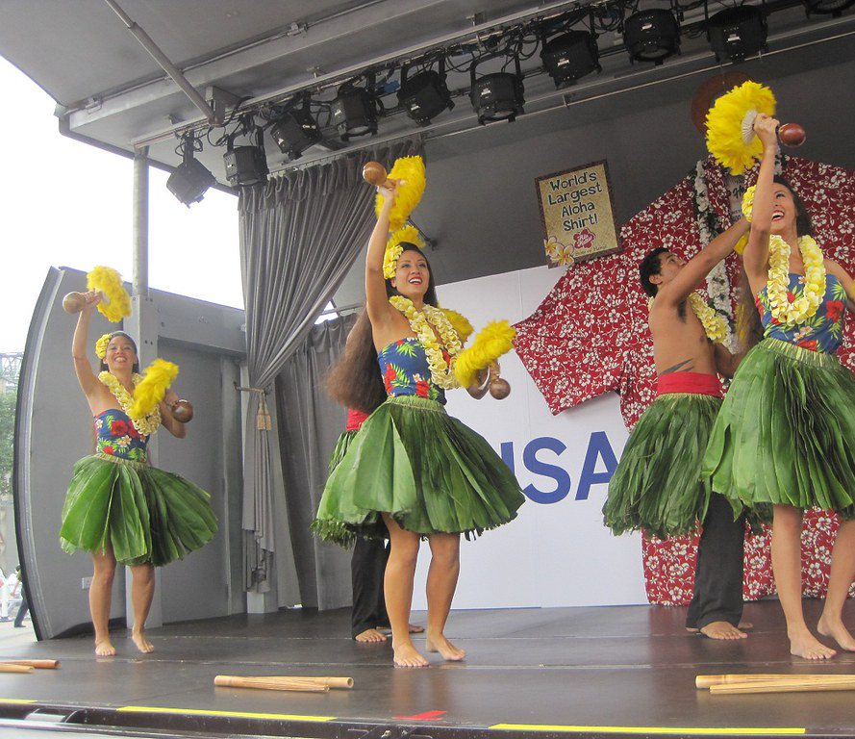
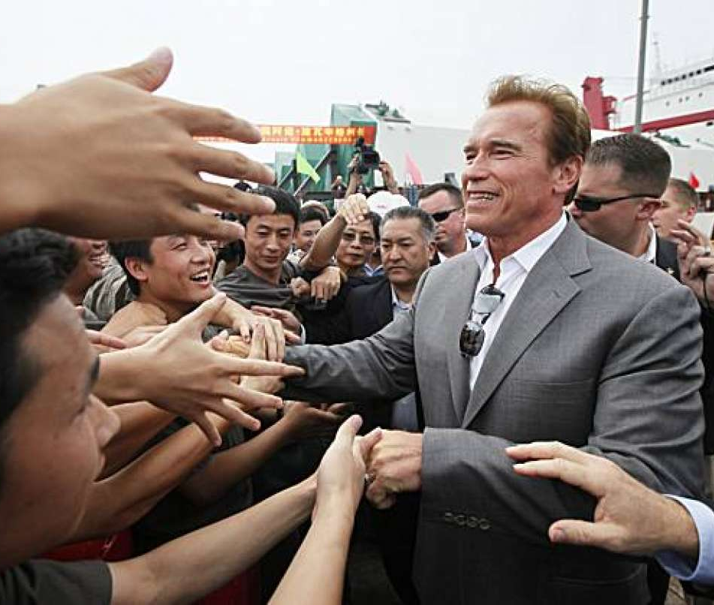
State Day Activities
Business roundtable discussions to promote investment
Panel discussion/keynote address on specific initiatives
Promote food/ag exports with sample giveaways, cooking demos, etc.
Small items/trinket giveaways
Tourism promotion
Cultural performers/cultural heritage
Highlight opportunities for foreign students to study in the state
Government-Government or Government-Business meetings with UAE counterparts or other International Participants
Catered event(s) in VIP Spaces
Looping video promotion

Slide 16
VIP Pavilion Spaces
The VIP function and meeting rooms at the USA Pavilion are elegant spaces designed to the American aesthetic. The Pavilion’s business program will feature a diverse range of Government to Government, Business to Business and Government to Business events. These invitation-only events will take place in a variety of formats including:
No charge to reserve the facility - catering and other costs (tickets) apply
sit-down lunch / dinner | morning / afternoon tea
reception/cocktail party | seminars and meetings

Slide 17
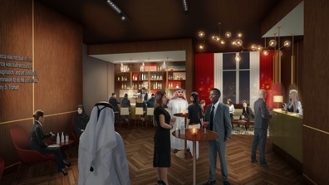
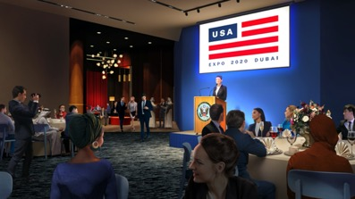
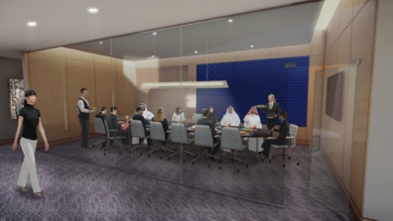
PAVILION FUNCTION SPACES
VIP FUNCTION SPACES
PRE-FUNCTION SPACE
Use for guest registration, arrival refreshments or an informal breakout space
FUNCTION SPACE
80 persons for a seated lunch / dinner
120 persons cocktail reception
100 persons seminar / theater style
CONFERENCE ROOM
16 guests meeting or seated dining format

Slide 18
Contact Us
Cindi Allen
Assistant Secretary of State
For
International Trade
cindi.allen@nebraska.gov
402-471-8408
Follow us: @usaexpo2020

Slide 19
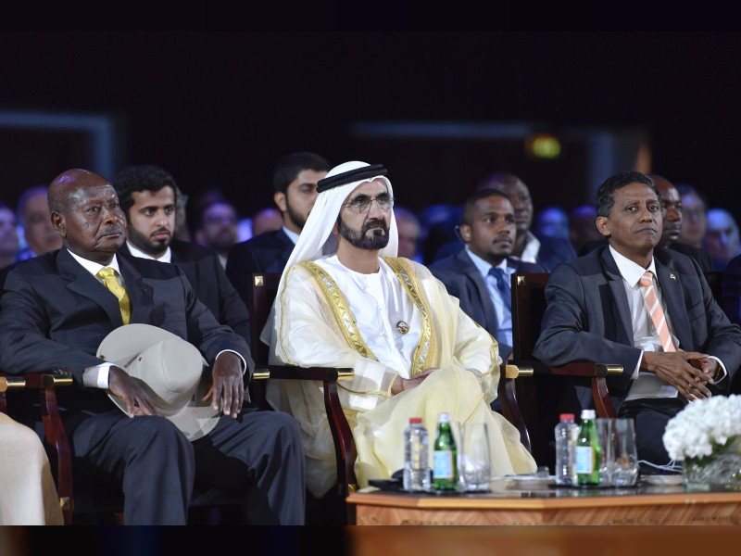
Global Business Forums
Expo 2020, in partnership with Dubai Chamber will host 3 Global Business Forums: Africa, Latin America, and for the first time ASEAN.
The Global Business Forums will involve prominent stakeholder, leading decision makers, as well as industry experts engaging in dialogues in areas that relate to overcoming global challenges, and fostering economic growth as well as trade and investment.
GBF AFRICA
Oct 13–14, 2021
GBF ASEAN
DEC 8–9, 2021
GBF LATIN AMERICA
MAR 23–24, 2022

Slide 20
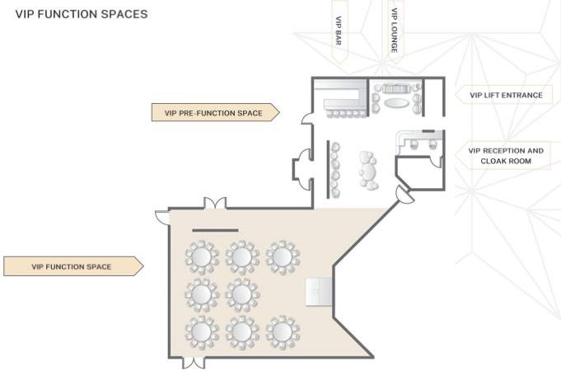
PAVILION FUNCTION SPACES
Conference Room

Slide 22
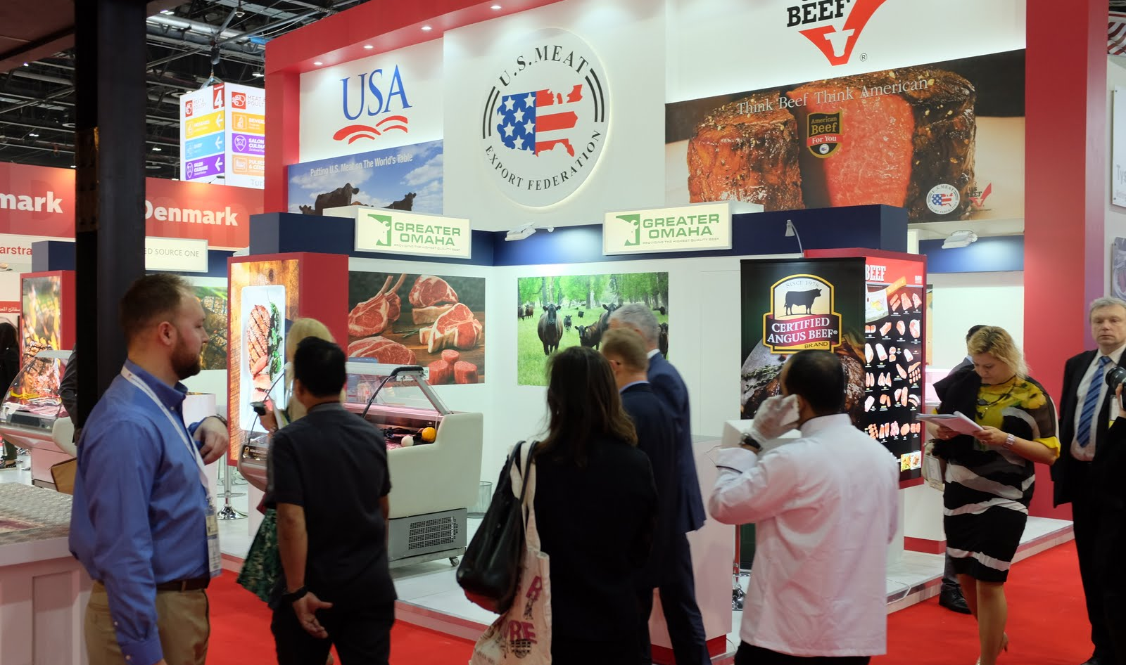
Gulfood Show Dubai February 12-17, 2022
https://www.gulfood.com/why-exhibit
Photo courtesy of
Greater Omaha Packing

Slide 23
Links to Understanding the World Expo
What to expect at the World Expo 2020 Dubai
https://www.expo2020dubai.com/en/experiences
Planning your visit to UAE
https://www.expo2020dubai.com/en/plan-your-visit/visiting-uae
FAQ
https://www.expo2020dubai.com/-/media/expo2020/pavilions/_content/pdf/expo2020-pavilionspremiere-faq-v3.pdf

